Slide 1
Managing stockouts in a healthcare manufacturing factory
Utkarsh Balooni | 22ds1000021

Slide 2

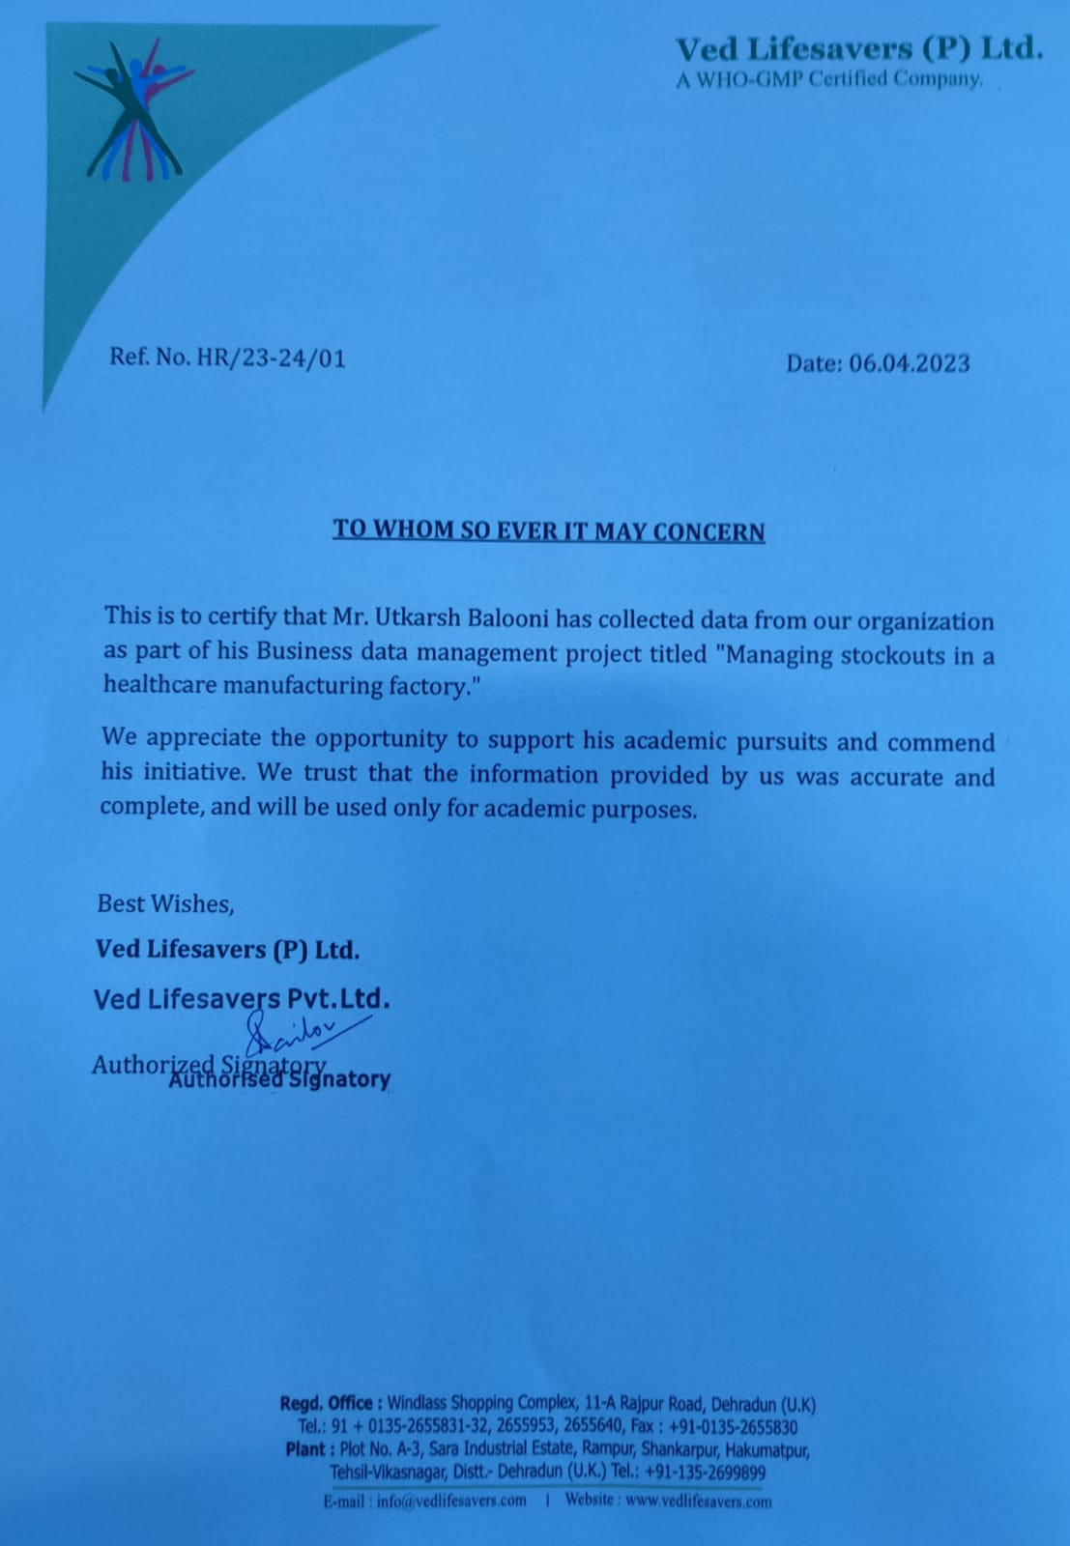
Organization Background
Name – Ved Lifesavers (P) Ltd.
Type – B2B organization
Location – Sara Industrial Estate, Selaqui, Dehradun (U.K.)
Established in 2012
Annual Turnover – 5 - 10 cr.
Major clients include Zydus Healthcare Ltd., Leeford Healthcare Ltd. and Lincoln Pharma

Slide 3
Objectives
Identify raw materials which contribute the most towards profitability of the factory.
Estimate the future demand for these products using previous sales data.
Calculate the lead time for the products.
Calculate the value of safety stock and reorder point for these products to streamline the manufacturing process.

Slide 4
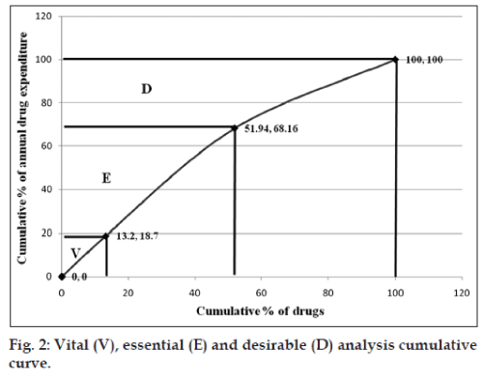
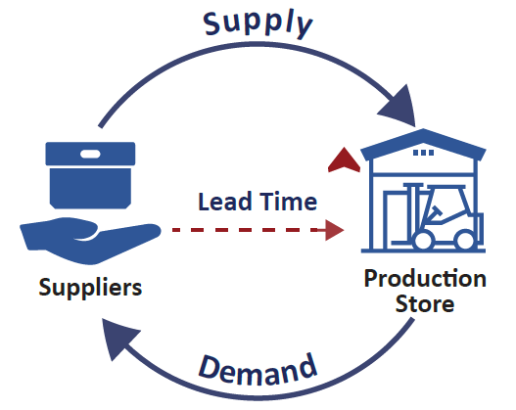
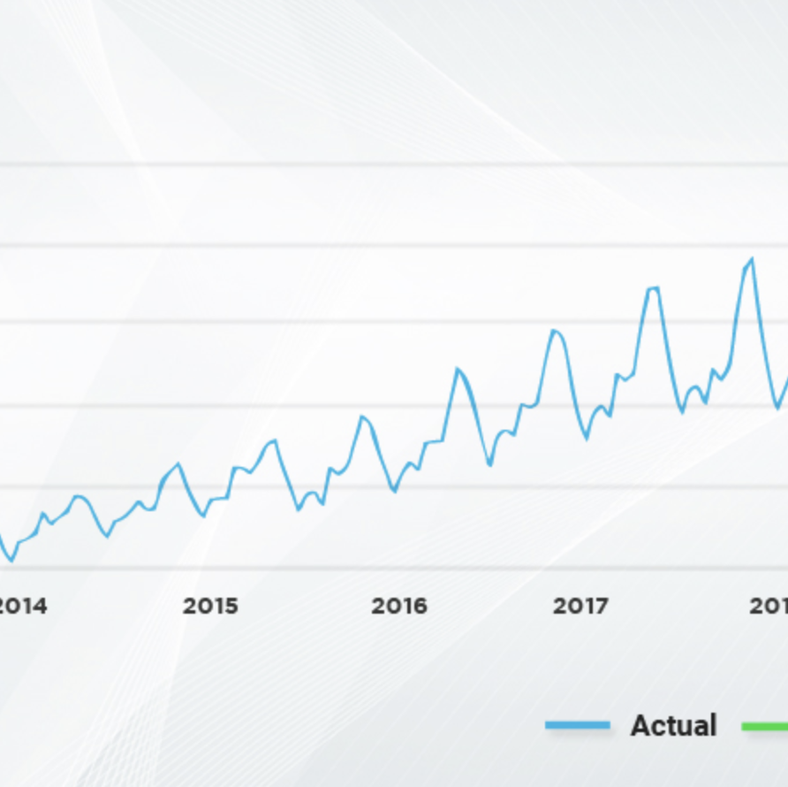
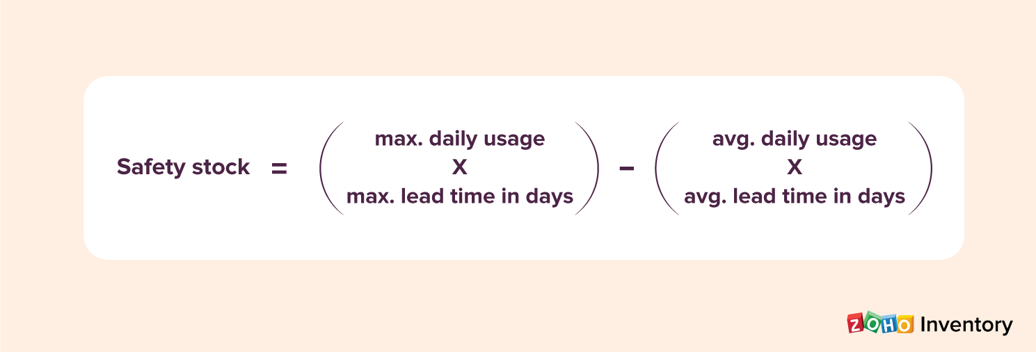
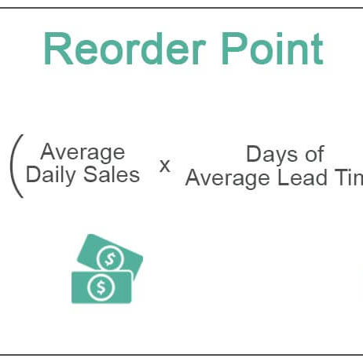
Methodology
ABC-VED analysis
Lead time calculation
Time series forecasting
Safety stock calculation
Reorder point calculation

Slide 5
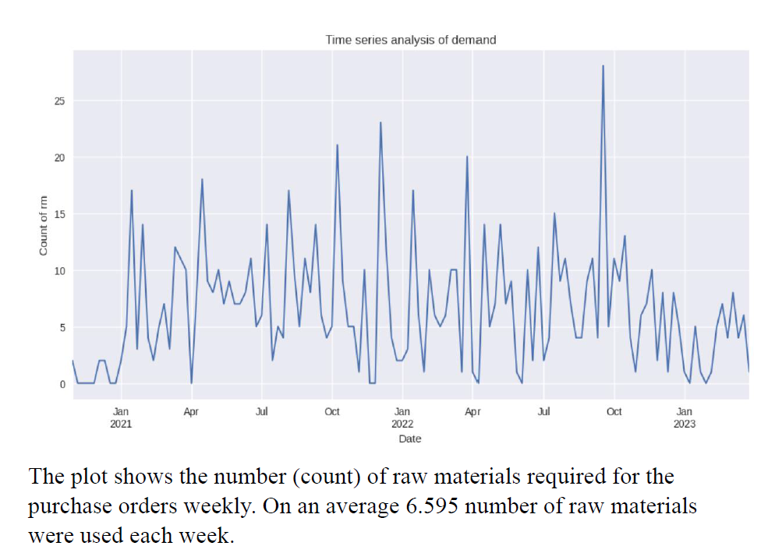
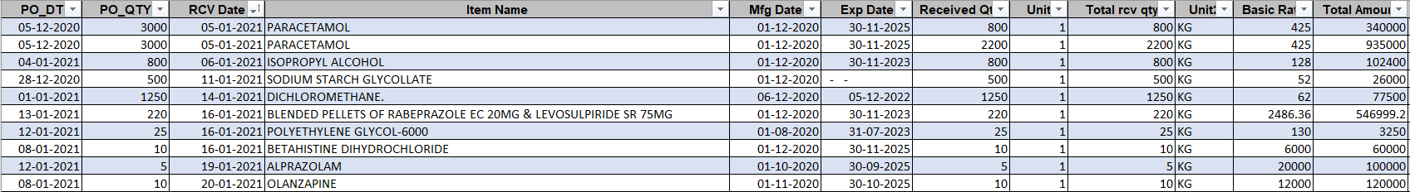
Data collection and Preprocessing
RM receiving against PO for the years 21-22, 22-23, 23-24 was collected.
Datasets were consolidated keeping only relevant columns.
Basic Pre-Processing was carried out.

Slide 6
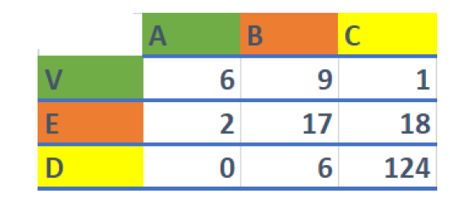
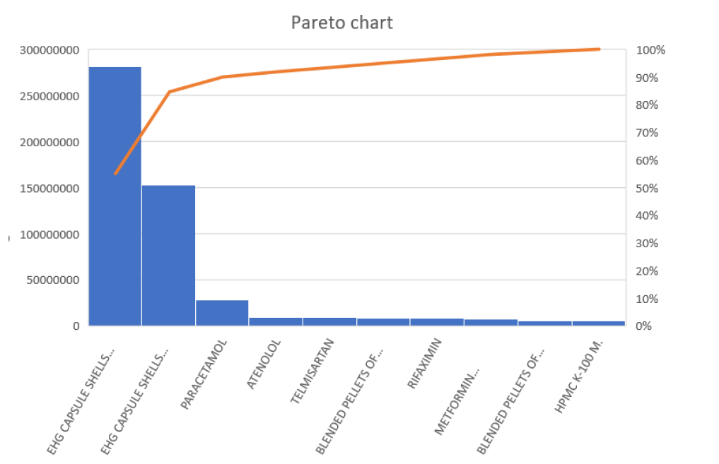
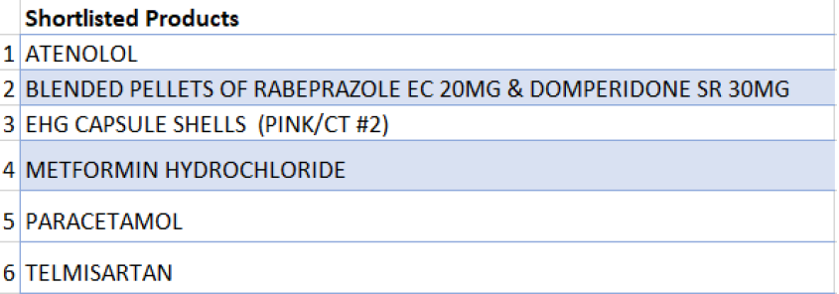
ABC–VED analysis
ABC – Total issue amount
VED – Total issue frequency
The chosen products account for 86% of the total issue amount and 40% of the total issue frequency.

Slide 7
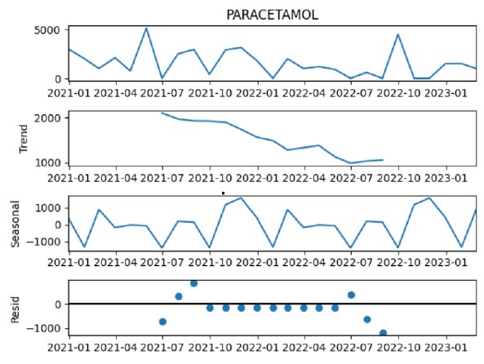
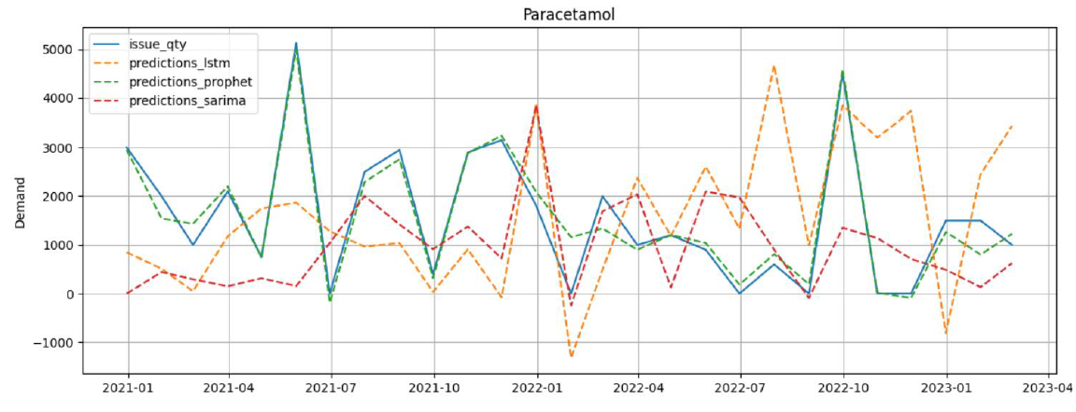
Demand Forecasting
Atenolol, Blended pellets, and Telmisartan depict an upward trend in demand, while Metformin Hydrochloride, and Paracetamol show a downward trend.
All products exhibit a seasonality pattern of approximately 12 months. (yearly)

Slide 8
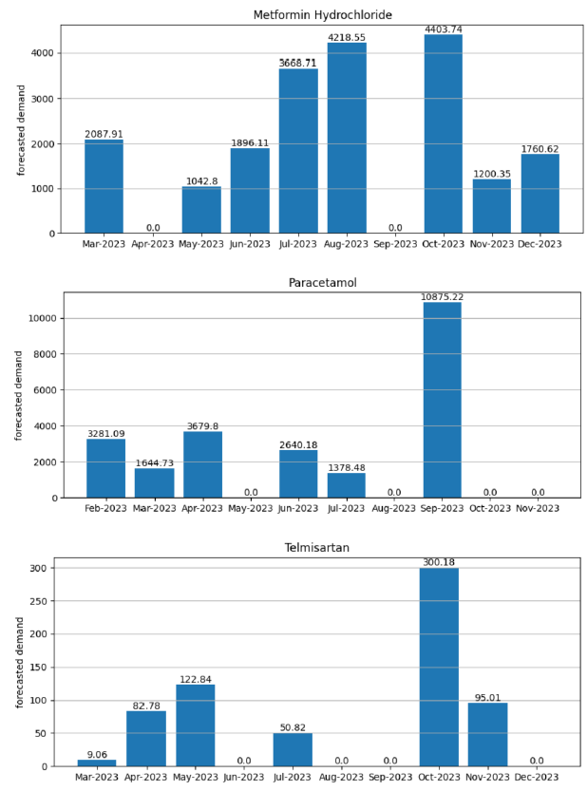
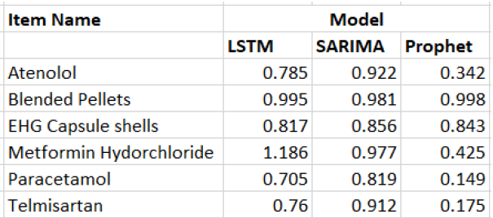
Prophet model gives the least MAE.
Demand for the products peaks around the months September-October. (May for Atenolol)
Demand for “Metformin Hydrochloride” is expected to rise and follow an upward trend in the upcoming period.

Slide 9
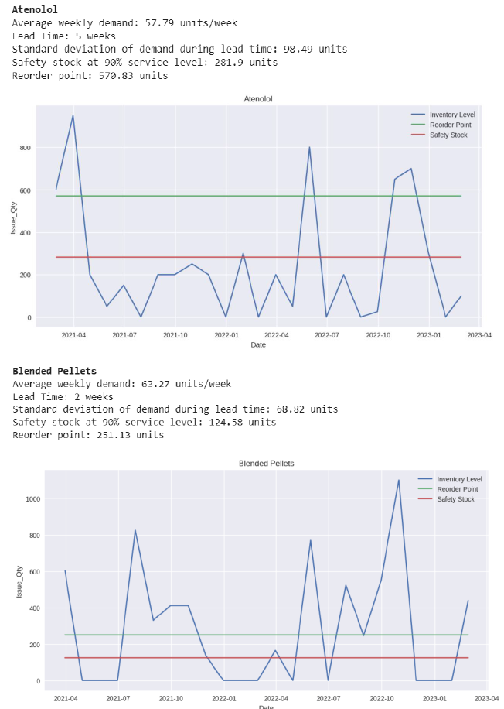
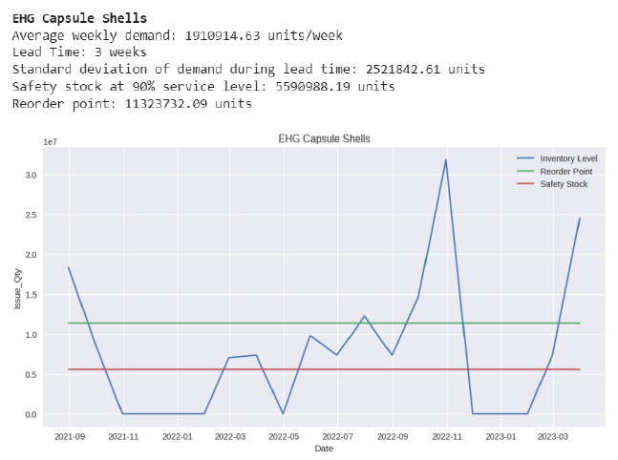
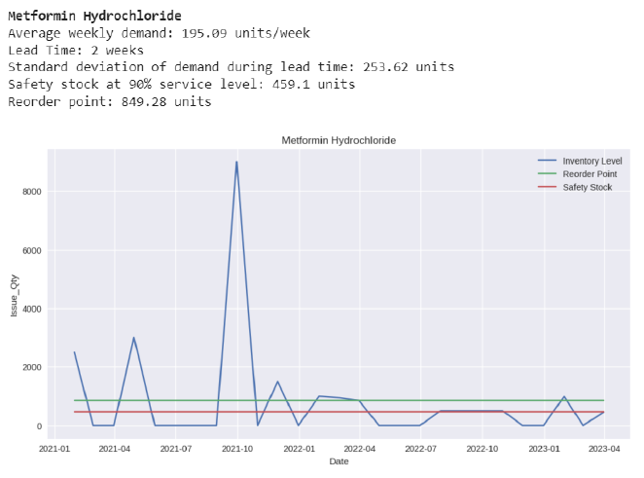
Safety stock and reorder point

Slide 10
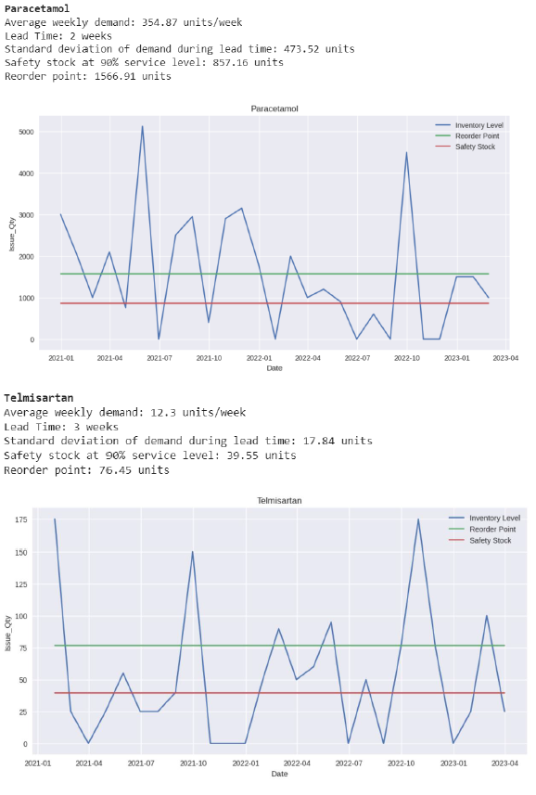
Recommendations
Increase manpower and resource allocation during the months of September-October.
Analyse the values of safety stock provided and consider keeping a buffer stock to prevent stockouts.
Place future orders using the value of reorder point provided.
Shortcomings
Although the data was collected for 2.5 years, the datapoints available for issue quantity of individual raw materials were still not enough for accurate demand forecasting. The data also contained a lot of noise which would have impacted the forecast.

Slide 11
Thank You

